Slide 1
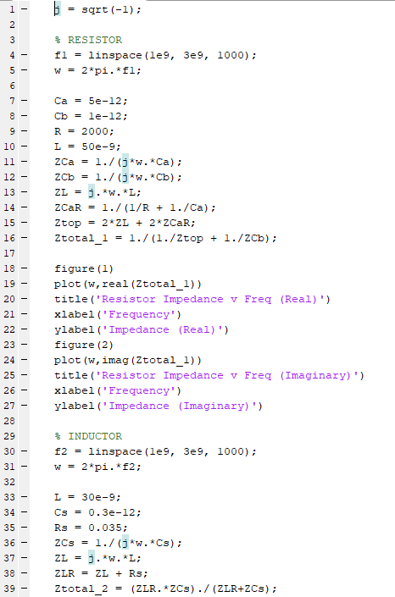

Introduction to MATLAB
Led by Nish, Jackie, Will, & Muchen
Notes:
Ethan

Slide 2
What is MATLAB?
MATLAB (matrix laboratory) is a numerical computing environment and programming language
MATLAB allows
Matrix manipulations
Plotting
Implementation of algorithms
Symbolic computing
Creation of user interfaces
Notes:
Ethan

Slide 3
Basic Syntax
Very similar to python
Operators: = (assignment), +, -, *, /, ^
Useful functions: sqrt(), exp(), cos(), sin(), sum()
Constants: pi = 3.1415…, eps = 2.2204e-16 (smallest amount by which 2 numbers can differ), inf (infinity), NaN (Not-number)
Logical Conditions: ==, >, <, >=, <=, ~= (not equal), ~ (not), & (Element wise and), |(or)
% for comments
; at the end of lines
help
Notes:
Nish

Slide 4
Control Structures
if
if(x==3)
disp(‘x is 3’)
elseif(x==5)
disp(‘x is 5’)
else
disp(‘x is neither 5 nor 3’)
end
for
for i=start:increment:end
loop contents
end
while
while(loopCondition)
loop contents
end
break used to break out of loops
s = 0;
while 1
if a > limit
break
end
s = s + a;
end
Notes:
Nish

Slide 5
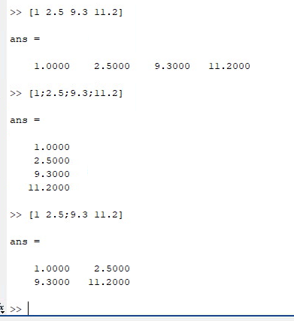
Matrices/Vectors
Enclosed under []
Rows separated by ;
Columns Separated by space
[1 2 9.3 11.2] is a row vector since it only has one row but 4 columns
[1; 2.5; 9.3; 11.2] is a column vector since it only has one column but 4 rows
Vector addressing done with (), so x(3) will be 3rd row of x
x(start:increment:end) will give all elements starting at start skipping everything until the next increment and ending end
Useful functions: diag(),eye() for identity matrix
Notes:
Nish

Slide 6
Matrices/Vectors
For the vector x = -4 : 2 : 10, use MATLAB to determine
length(x)
size(x)
x’
size(x’)
min(x)
max(x)
sum(x)
find(x)
find(x < 0)
find(x,3)
Notes:
Jackie

Slide 7
Plots
plot(x,y) % plot y vs x where x and y are vectors and have equal number of elements
Labelling can be done using xlabel() and ylabel(), title() (to title the graph)
“hold on;” to draw several plots in the same window
figure; to open a new window for plots/graphs
legend() to add legends
subplot() for subplots
Notes:
Will

Slide 8

Plot Exercise
Plot y(t)
Step 1: Generate a time vector t of 1000 points uniformly spaced between 0 and 10
Step 2: Generate a vector y whose elements represent the values of the response at the time instants in t
Step 3: Plot y versus t, and use the legend() to label the curve
plot(x,y) % plot y vs x where x and y are vectors and have equal number of elements
Labelling can be done using xlabel() and ylabel(), title() (to title the graph)
“hold on;” to draw several plots in the same window
figure; to open a new window for plots/graphs
legend() to add legends
subplot() for subplots
Notes:
Will

Slide 9
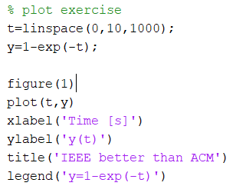
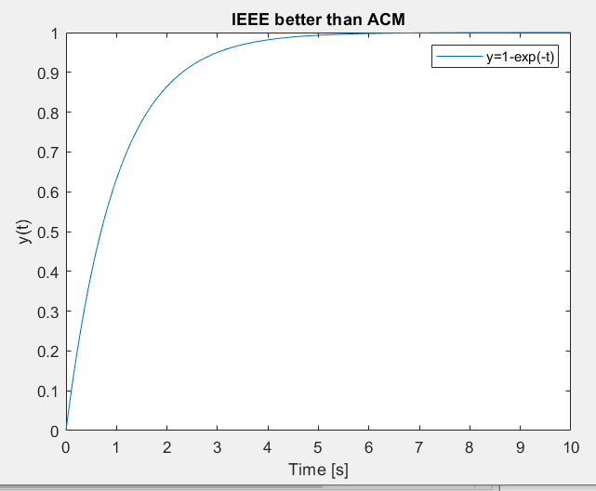
Notes:
Will

Slide 10
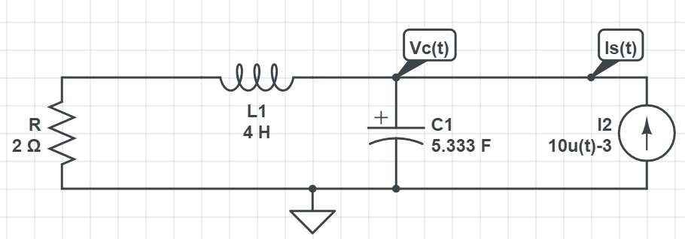
A problem from EE 210
Determine and Sketch Vc(t)
ⓒ PSU EE210 notes: second-order RLC circuit
Notes:
Muchen

Slide 11
A problem from EE 210
Determine and Sketch Vc(t)
What is the general solution algorithm for driven RLC circuits with a constant source present after t=0?
ⓒ PSU EE210 notes: second-order RLC circuit
Notes:
M

Slide 12
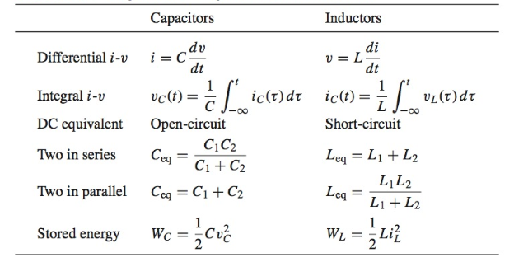
A problem from EE 210
Determine and Sketch Vc(t)
ⓒ PSU EE210 notes: second-order RLC circuit
Notes:
M

Slide 13

A problem from EE 210
Determine and Sketch Vc(t)
Vc(t) = -6 t<0
= t>0
ⓒ PSU EE210 notes: second-order RLC circuit
Notes:
https://electricalacademia.com/basic-electrical/inductor-capacitor-basics/

Slide 14
A problem from EE 210
Determine and Sketch Vc(t)
ⓒ PSU EE210 notes: second-order RLC circuit
Notes:
M

Slide 15
A problem from EE 210
Determine and Sketch Vc(t)
With MATLAB you can sketch without determining Vc(t)!
ⓒ PSU EE210 notes: second-order RLC circuit
Notes:
M

Slide 16
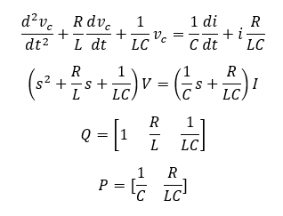
A problem from EE 210
Step1: define variables R,C,L
Step2: rewrite ODE with characteristic polynomial
step3: define vectors P,Q
step4: create time vector, input vector and output vector like what we did
step5: use lsim() command
step6: just plot!
ⓒ PSU EE210 notes: second-order RLC circuit
Notes:
M

Slide 17
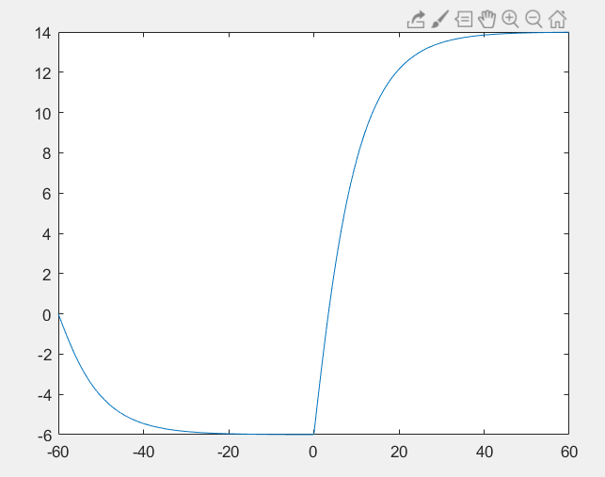

Slide 18
Thanks for attending!
See you next time!

